Slide 1



Slide 2


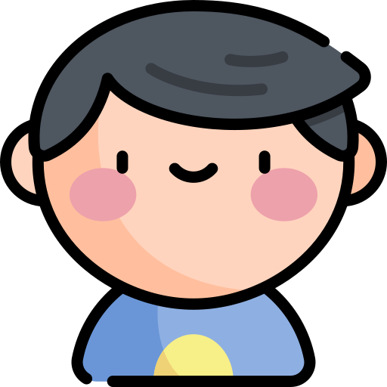


Name
Select Character

Slide 3


Select Voice Language
English
Filipino

Slide 4





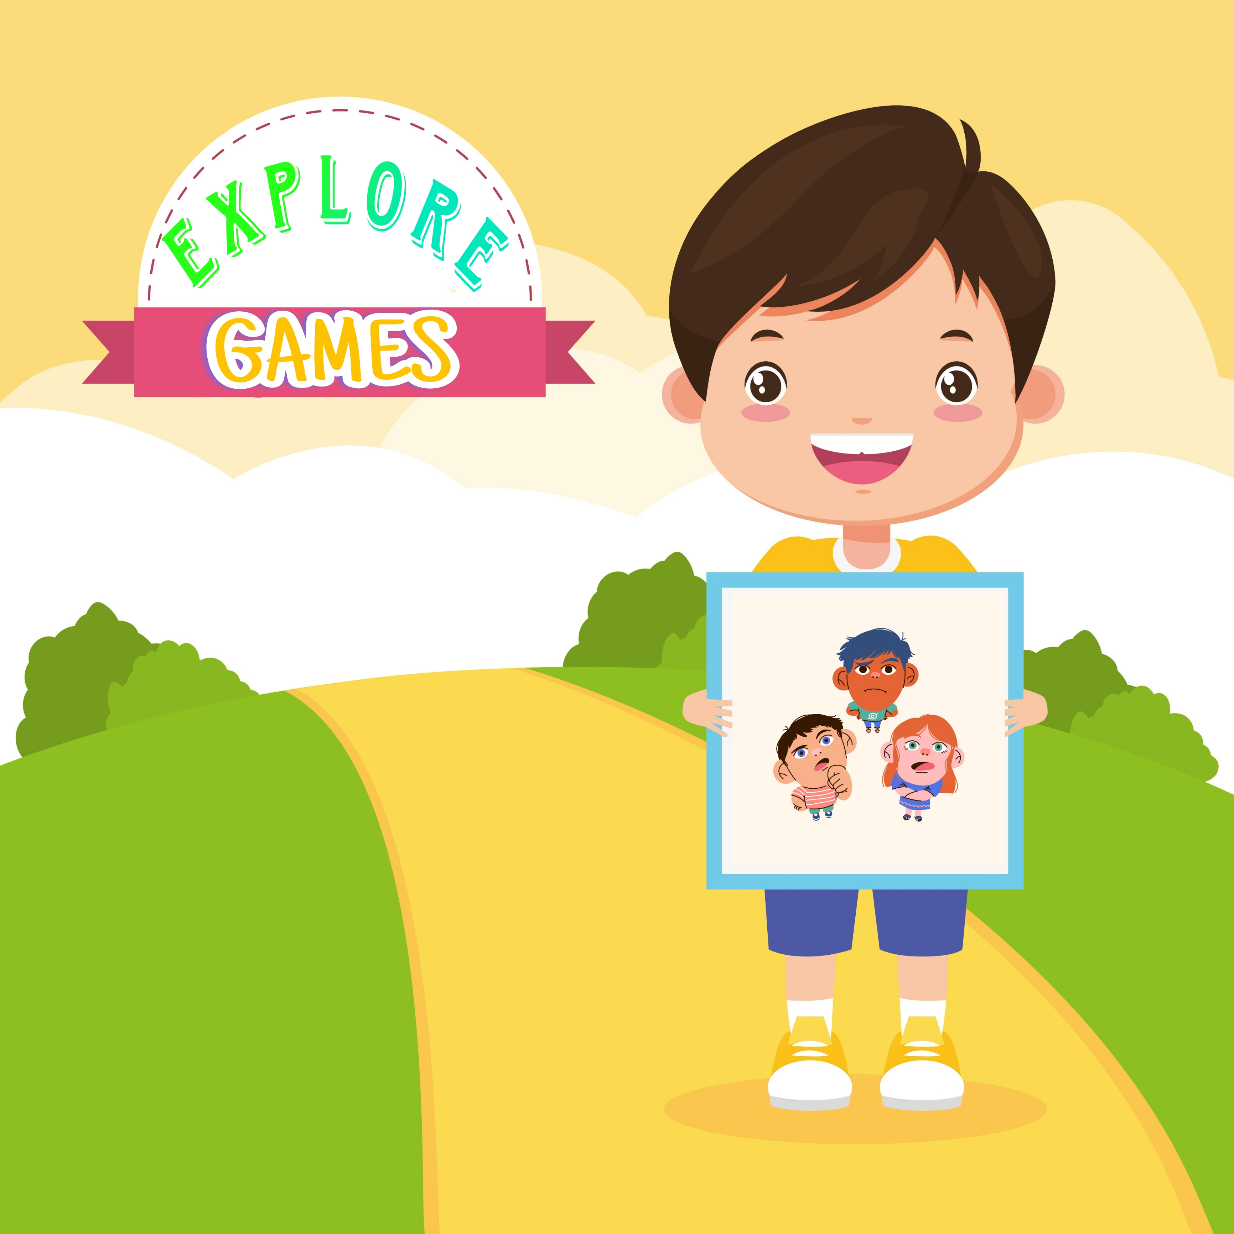
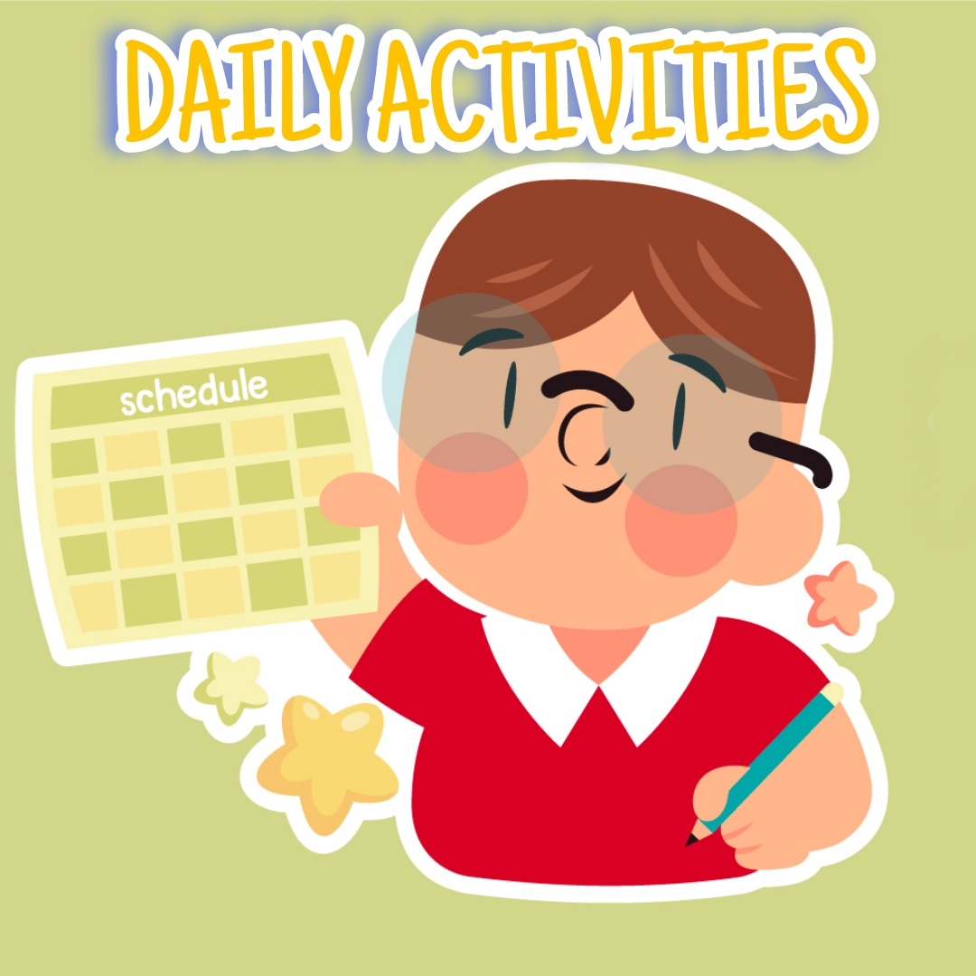

Slide 5



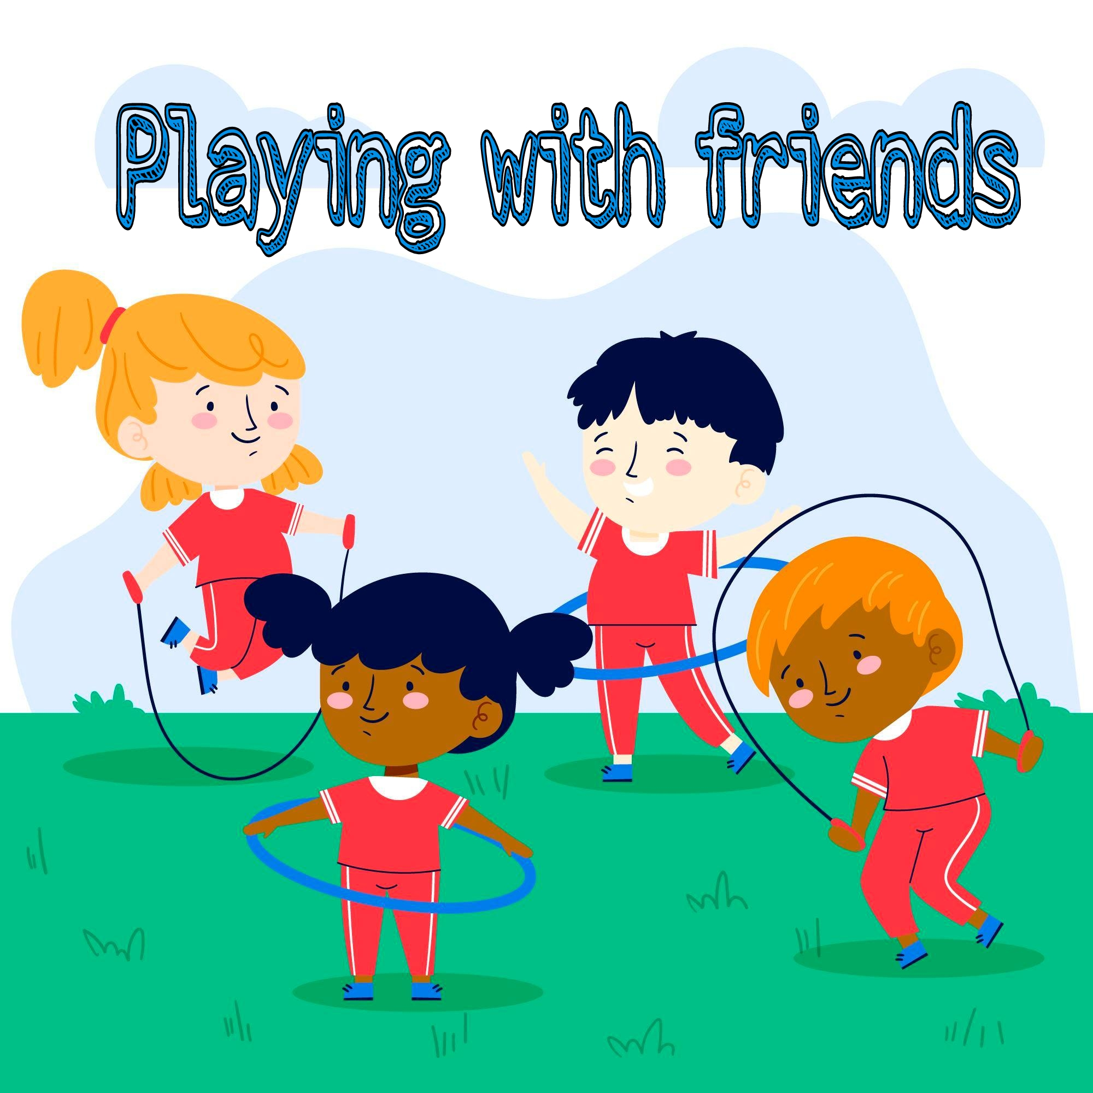



Slide 6


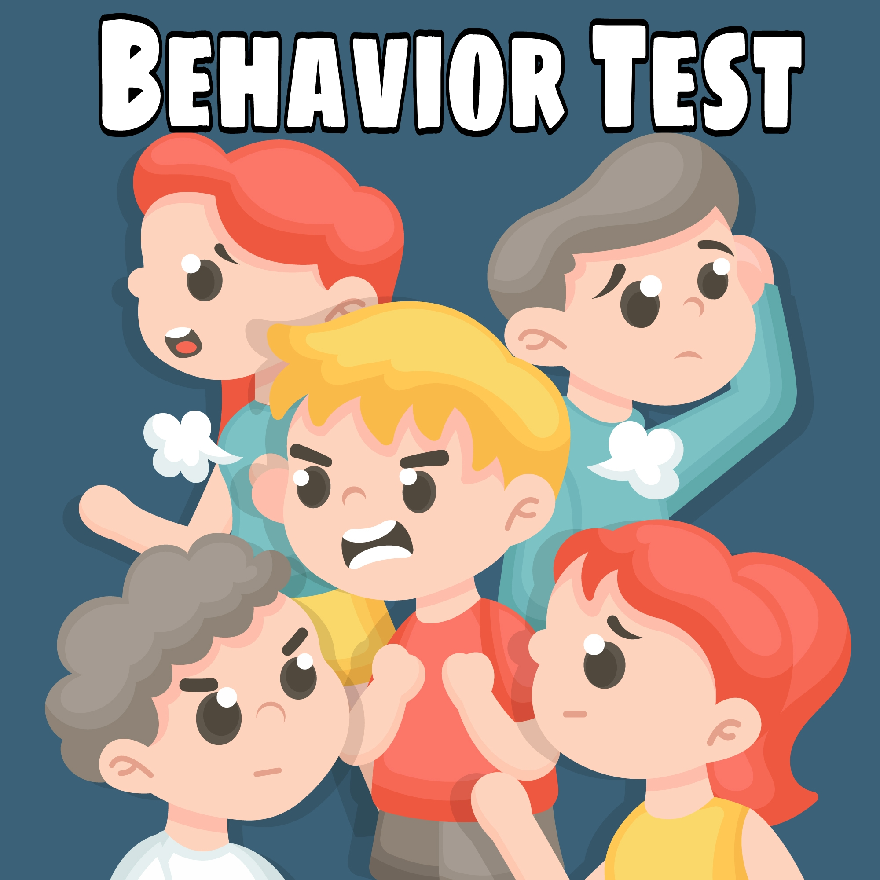


Slide 7








Slide 8






Level 1
Page 1/5

Slide 9
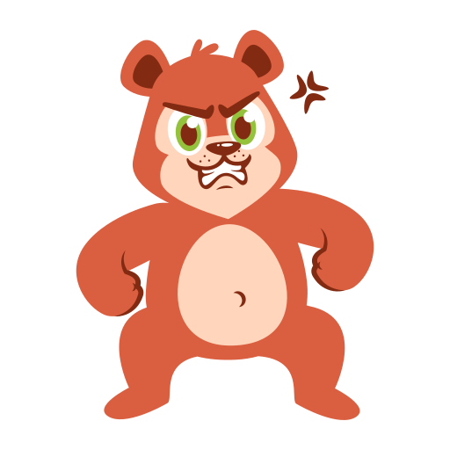
Level 1
Page 4/5

Slide 10

Level 1
Page 5/5

Slide 11





SUCCESSFUL 5/5
New Achievement Unlock – Guess Emotion Easy
Level 1
Page 5/5

Slide 12



